Slide 1
Face the Music 🎶
A project by Gal Kashi and Chen Eilon

Slide 2
Introduction
Communication with machines is a part of our everyday life.
Humans communicate with each other with more than just words, but with body language too.
In fact, studies show that body language is the most significant component of personal communication.
What if we could communicate with machines using facial expressions?

Slide 3
Our Idea
Based on a given facial expression, identify the expressed emotion.
Use that information to play a suitable playlist.

Slide 4
Approach
Use machine learning to train an emotion classifier.
We want to classify the following emotions:
Neutral, Happiness, Sadness, Surprise, Fear, Disgust and Anger.
For that, we need to collect data, train a classifier, and test the results.

Slide 5
Are There Universal Facial Expressions?
According to Paul Ekman, there are six basic emotions:
Certain facial expressions in all cultures
Happiness, Sadness, Surprise, Fear, Disgust and Anger.
Lets take a little test…

Slide 6
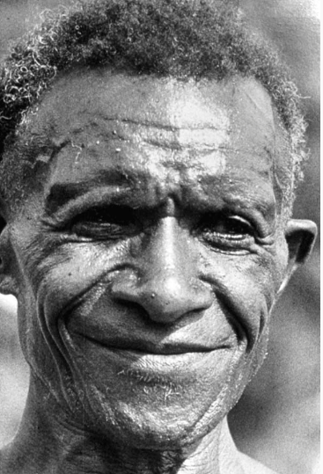
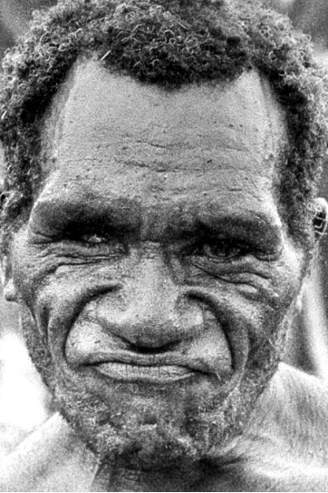
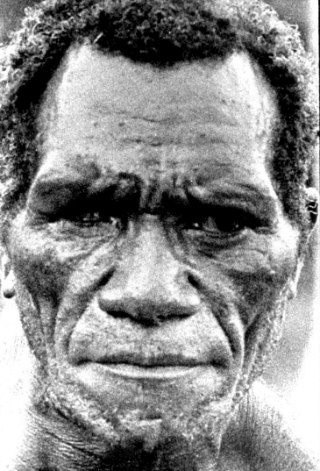
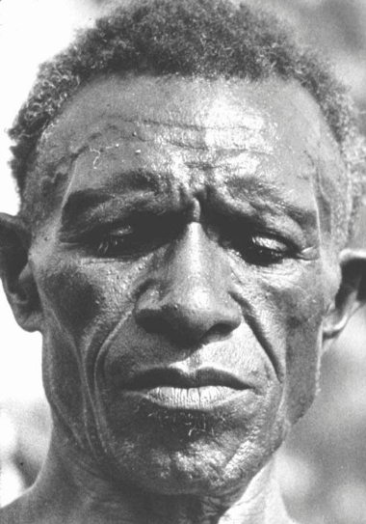
Dr. Paul Ekman Basic Emotions Theory
The New Guinea man featured below:
Living in an isolated, preliterate culture
Using stone implements
Never seen any outsiders before.
His child had just died
He stepped on a smelly dead pig
He was about to fight
Friends had come

Slide 7
Data Description
The data we used is comprised of pictures of people faces.
The faces in the pictures express various emotions.
We dealt with two types of samples:
Wild – Context free pictures, found online, and include one sample per subject.
Posed – Subjects are volunteers who expressed some or all of the emotions.
All data was manually labeled by human annotators.

Slide 8
Datasets
AffectNet
Collected by the Department of Electrical and Computer Engineering, University of Denver.
Wild samples.
About 400,000 samples.
Extended Cohn-Kanade (CK+)
Collected by Carnegie Mellon University, Pittsburgh.
Posed samples.
123 subjects.

Slide 9
Datasets
Multimedia Understanding Group (MUG)
Collected by Aristotle University of Thessaloniki, Greece.
Posed samples.
52 subjects.
Oulu CASIA NIR&VIS facial expression database
Collected by the University of Oulu, Finland.
Posed samples.
80 subjects.

Slide 10
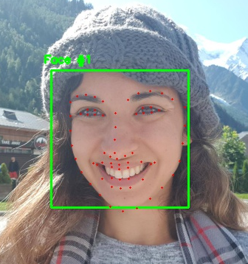
Landmarks
We used a trained neural network, dlib, to extract “landmarks” from the samples.
The landmarks are a set of 68 points, marking points of interest in the human face.
We chose a subset of 30 landmarks and used them to calculate the features for our models.

Slide 11
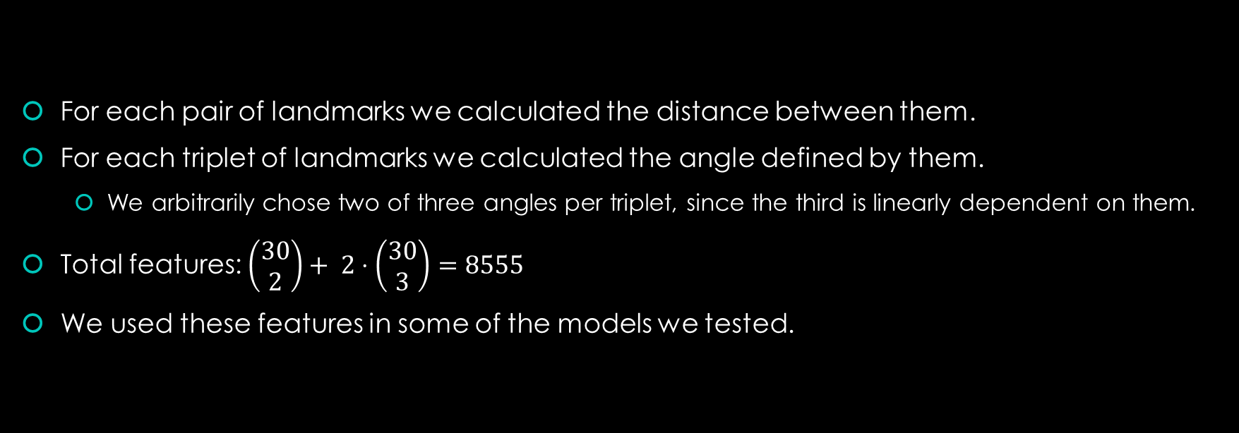
Features

Slide 12
Training: 1st Phase
In our 1st phase of training, we used several machine learning models to train a classifier on the wild samples dataset.
Since the data is imbalanced, we used 2000 samples from each class. 90% of which used as train data, and the rest as test data.
In an attempt to achieve better results, we trained the classifier to identify different subsets of classes.

Slide 13
Logistic Regression
Cross validation yielded 0.1 as the best value for the C parameter.
89.75% accuracy for binary classification (happy and sad samples only).
49.5% accuracy for all classes.

Slide 14
KNN
Cross validation yielded 3 as the best value for the K parameter.
79.25% accuracy for binary classification.
29.2% accuracy for all classes.

Slide 15
Convolutional Neural Network
This model receives the raw images as input, i.e. it doesn’t use the calculated features.
The neural network architecture:
3 2D convolutional layers, a max pooling layer, a dropout layer, a fully connected layer, another dropout layer, and another fully connected layer.
90.2% accuracy for binary classification.
46% accuracy for all classes.

Slide 16
Training: 2nd Phase
In our 2nd phase of training, we trained a classifier on the posed samples datasets.
This time, for each samples we subtracted from its feature vector the feature vector of the corresponding neutral sample.
We used the results as new feature vectors.
We trained the classifier on 6 classes: Happiness, Sadness, Surprise, Fear, Anger, Disgust

Slide 17
Logistic Regression
Again, cross validation yielded 0.1 as the best value for the C parameter.
85% accuracy.

Slide 18
MLP Classifier
Cross validation yields 1 as the best value of the alpha parameter.
85% accuracy

Slide 19
Application
We chose the 2nd phase Logistic Classifier for our final application.
We implemented a demo app using python and the PyQt toolkit.
Using the app starts with a short training session:
The user expresses a neutral expression to calibrate his/her neutral feature vector.
Then, the app will continuously monitor the user’s face, extract landmarks, calculates features, and classify his/her expressed emotion.

Slide 20
Optimization
Calculating features for every single frame can be heavy.
To improve performance, we choose “important” frames to calculate features from.
“Important“ frame is a frame which is suspected to have an emotion change.
For each frame we calculate a vector of Euclidian distances between all landmarks. Then we calculate the Euclidian distance between the frame’s vector and the previous “interesting” frame’s vector.

Slide 21
Resources
http://www.rightattitudes.com/2008/10/04/7-38-55-rule-personal-communication/
https://arxiv.org/pdf/1708.03985.pdf
https://ieeexplore.ieee.org/document/5543262/
https://mug.ee.auth.gr/fed/
http://www.oulu.fi/cmvs/node/41316
https://www.paulekman.com/universal-facial-expressions/

